Slide 1
Lesson 1
The Linear Regression Model

Slide 2
Simple linear regression
The linear model:
Can use a linear model to describe the relationship between x and y:
y_{i} is the response variable
x_{i} is the predictor variable.
y
β₀ is the intercept (the value of y when x = 0)
β₁ is the slope of the regression
(the change in y for every unit of x)
x

Slide 3

Simple linear regression
The linear regression model:
Can use a linear regression to fit a best linear relationship between x and y for some data:
y
Here:
i are pairs of (x,y) values measured,
y_{i} is the response variable
x_{i} is the predictor variable
e_{i} are the distances between
observed y_{i} and predicted
$$ε_{i}$$
x

Slide 4

Regression calculation
Simple regression uses the method of least squares estimation (OLS):
regression fits the best line through the data by
minimising the sum of squared errors:
This requires differentiation w.r.t. β₀ and β₁.
y
$$ε_{i}$$
x

Slide 5
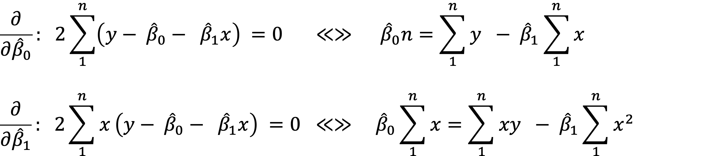
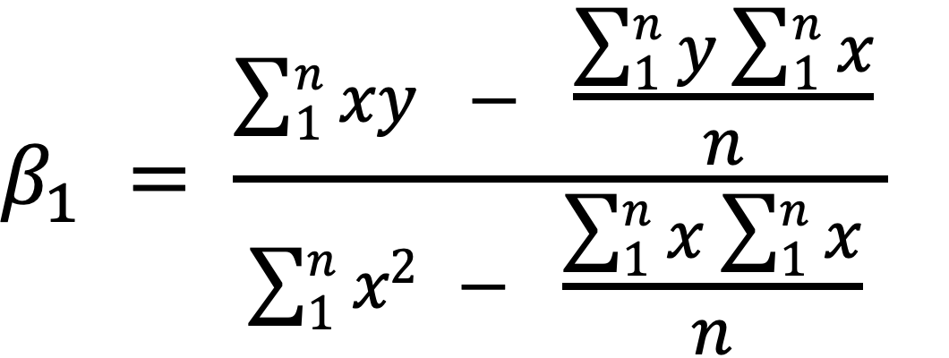
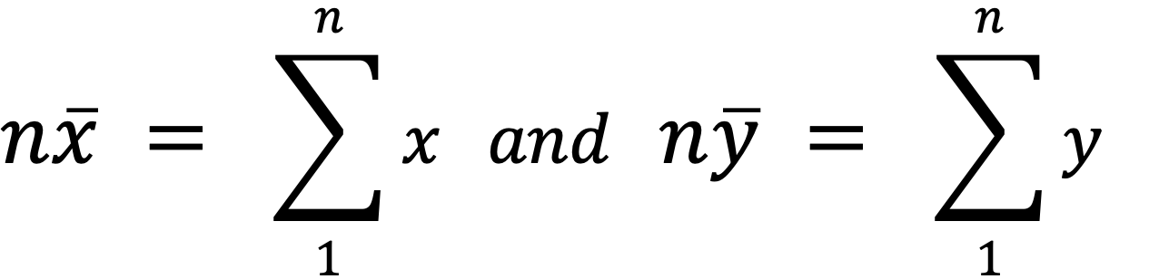
Finding the coefficients, β_{i}
Take partial derivatives wrt to β₀ and β₁
Solve for β₁ by equating β₀
_{wher}
Notes:
Finding mimimization by calculus

Slide 6
Finding the coefficients, β_{i}
To calculate the slope (β₁) we need to calculate:
This can also be written as:
To calculate intercept (β₀):

Slide 7
Estimating the residual variance
Statistical tests require the residual variance of the model to quantify the uncertainty (s.e.) of β_{i}
Notes:
Estimate mean and variance (sum of squares of resiuals). Giving average estimate between average estimation and prediction.

Slide 8


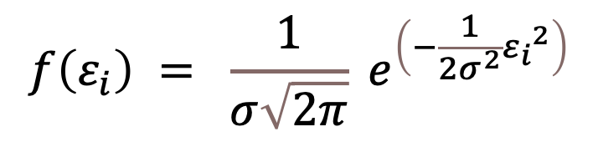

The normal distribution
The residuals, $ε_{i}$, of this model are assumed to follow the normal distribution with mean $μ$, and variance $σ$².
y
$$ε_{i}$$
x
$$f\left(ε_{i}\right) = \frac{1}{σ\sqrt{2π}} e^{\left(−\frac{1}{2σ^{2}}{ε_{i}}^{2}\right)}$$
0
$$ε_{i}$$
Notes:
Residual is distance between the point and fitted line. All the residuals below the line are negative anf all the lines above line are positive. Average value of residuals is always zero. Small residuals are quite common. Large residuals are rarer in bothe positive and negative side.. Distrivution of residuals is normally bell shaped curve. Large variance more uncertainity. Less variance more certainity. Normal distribution : -infinity to infinity. Area under this 1 because we are talking about probability. Parametric distribution sum to 1.

Slide 9
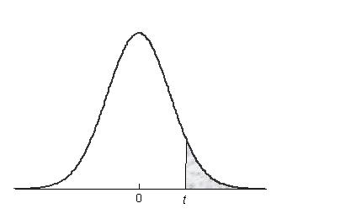

Hypothesis testing
Main hypothesis: the slope, β₁ ≠ 0
H₀: β₁ = 0
y
x
Coefficients:
Estimate s.e. t value Pr(>|t|)
(Intercept) 22.440 3.4841 6.441 1.55e-05 ***
Temperature 1.015 0.2379 4.268 0.000781 ***
Notes:
If the line is flat there is no relationship. Coefficient test in linear models are t-tests. Tvalues are large things are significant, t values are small not significant.

Slide 10
Interpreting linear models
Linear models can deal with both continuous and categorical predictor variables simultaneously
Ordinal predictors = variates (e.g. age)
(continuous/discrete)
Categorical predictors = factors (e.g. sex)
Notes:
Ordinal: ranked values: counts,

Slide 11
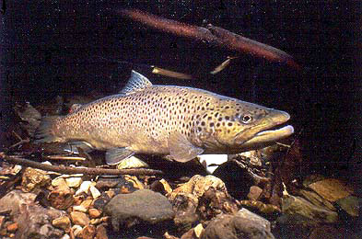

Example 1A
A researcher measures the maximum swimming speed of 10 brown trout and 10 Canterbury galaxias at a range of temperatures.
Response (Y) = swimming speed
Predictor Factor = species → dummy variable (D)
Predictor Variate (X₁) = temperature

Slide 12
Example 1A
 |  | X₁ | Y | D
Obs. No. | Species | Temperature (ºC) | Speed (cm/s) | Dummy Variable
1 | Trout | 3 | 48.1 | 0
2 | Trout | 6 | 51.2 | 0
3 | Trout | 11 | 73.1 | 0
4 | Trout | 12 | 78.1 | 0
5 | Trout | 15 | 81.1 | 0
6 | Trout | 21 | 94.5 | 0
7 | Trout | 24 | 99.0 | 0
8 | Trout | 26 | 115.3 | 0
9 | Trout | 28 | 113.7 | 0
10 | Trout | 30 | 118.7 | 0
11 | Galaxias | 4 | 26.1 | 1
12 | Galaxias | 9 | 33.7 | 1
13 | Galaxias | 12 | 31.4 | 1
14 | Galaxias | 14 | 38.5 | 1
15 | Galaxias | 15 | 36.9 | 1
16 | Galaxias | 17 | 39.1 | 1
17 | Galaxias | 18 | 42.2 | 1
18 | Galaxias | 21 | 43.3 | 1
19 | Galaxias | 25 | 58.9 | 1
20 | Galaxias | 28 | 54.3 | 1
Notes:
Dummy variable helps understand ho the model is created. Categorical predictor data needs dummy varables.

Slide 13
Example 1.1
Open the data “fishspeed.csv” in R
(1) Run speed as a function of temperature using lm(). Write out the model.
(2) Run speed as a function of species using lm(). Write out the model.
(3) Compare fishspeed of species using t.test() (please specify: var.equal=TRUE)
(4) Compare (2) and (3)

Slide 14
Example 1A: some output
Note that the lm() output gives you the β estimates with standard errors plus t-tests evaluating significance
The output also gives you an R² value, which is a goodness-of-fit measure (how well model explains data)
It also gives you the residual standard error = sqrt(σ²), from which the coefficient s.e.’s are derived.
Coefficients:
Estimate s.e. t value Pr(>|t|)
(Intercept) 17.340 11.967 1.449 0.1667
Temperature 2.979 0.677 4.401 0.0004 ***

Slide 15
Matrix calculations
How regression models actually calculate the parameters for linear models

Slide 16
Linear models in Matrix notation
Linear models written in expanded form
Or in compound matrix notation
Where y is the vector of response values, capital X is a matrix of predictor values, β is a vector of regression coefficients (𝝱₀,𝝱₁), and ε is a vector of residuals.
Matrix algebra allows us to solve linear regressions simply and powerfully

Slide 17
Finding the coefficients, β_{i}
Recall for simple linear regression (one predictor):
This can be solved for p predictors using matrix algebra:

Slide 18
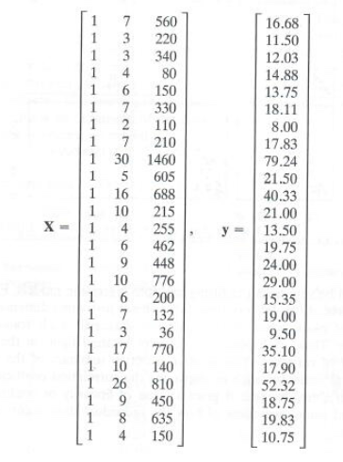
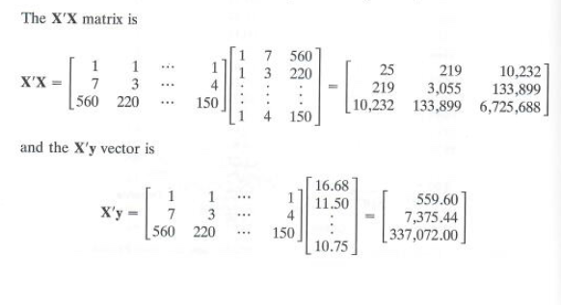
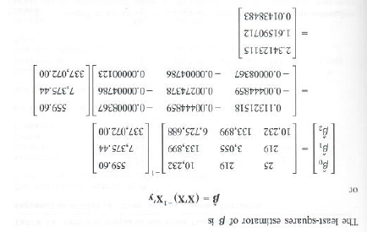
Int.
X1
X2
Y

Slide 19

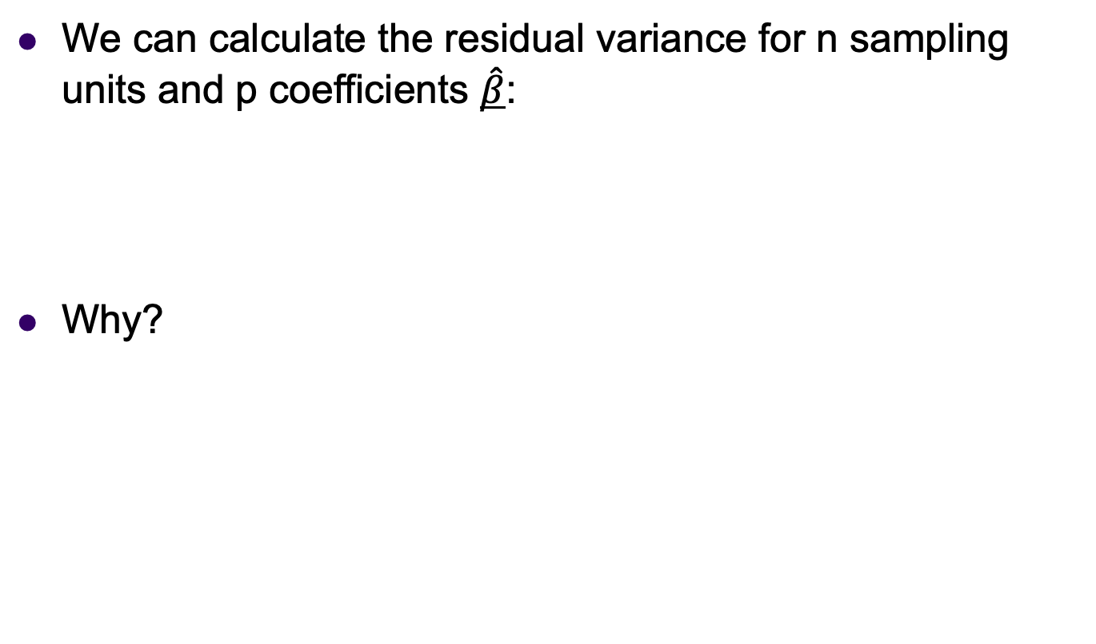
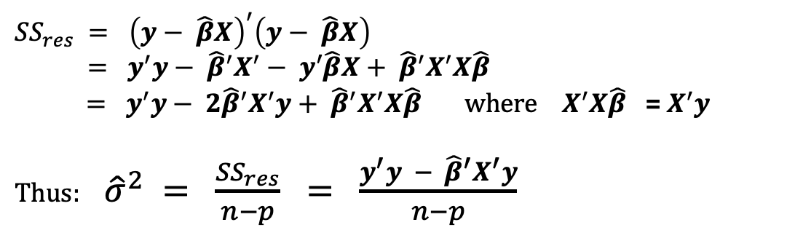

Slide 20
Example1.2
Matrix OLS solution of LM
Use the fishspeed data to solve the beta coefficients for:
(1) Speed ~ Temperature
(2) Speed ~ Species

Slide 21
Multi-linear models
The underlying linear models can be extended from simple linear models
to models with multiple variables and interactions.
$$y_{ijk}= β_{0}+β_{1}x_{1}+β_{2}x_{2} +β_{3}x_{1}x_{2}+ε_{ijk}$$

Slide 22
Interpreting multilinear models
Regression models with factors and variables have separate regression lines for each factor level
Y
b₁
1
b₁
1
X₁

Slide 23
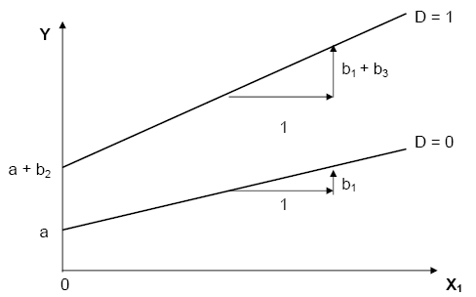
Modelling interactions
a = intercept for level 1 (D=0)
b₁ = regression slope for level 1
b₂ = difference in intercepts of the two lines = Y₁ – Y₂ when X =0
b₃ = difference in slopes of the two lines

Slide 24
Fishspeed Example
A researcher measures the maximum swimming speed of 10 brown trout and 10 Canterbury galaxias at a range of temperatures.
NOW he wants to know whether the two fish species respond differently to temperature.
=> INTERACTION

Slide 25
Recall the data
 |  | X₁ | Y | D
Obs. No. | Species | Temperature (ºC) | Speed (cm/s) | Dummy Variable
1 | Trout | 3 | 48.1 | 0
2 | Trout | 6 | 51.2 | 0
3 | Trout | 11 | 73.1 | 0
4 | Trout | 12 | 78.1 | 0
5 | Trout | 15 | 81.1 | 0
6 | Trout | 21 | 94.5 | 0
7 | Trout | 24 | 99.0 | 0
8 | Trout | 26 | 115.3 | 0
9 | Trout | 28 | 113.7 | 0
10 | Trout | 30 | 118.7 | 0
11 | Galaxias | 4 | 26.1 | 1
12 | Galaxias | 9 | 33.7 | 1
13 | Galaxias | 12 | 31.4 | 1
14 | Galaxias | 14 | 38.5 | 1
15 | Galaxias | 15 | 36.9 | 1
16 | Galaxias | 17 | 39.1 | 1
17 | Galaxias | 18 | 42.2 | 1
18 | Galaxias | 21 | 43.3 | 1
19 | Galaxias | 25 | 58.9 | 1
20 | Galaxias | 28 | 54.3 | 1

Slide 26
Example: 1.3
The Fishspeed data
Formulate the linear model
Run the regression model in R
Write out the solution model

Slide 27
Results: coefficients
Model for galaxias:
Speed = 22.440 + (1.015*Temp)
Model for trout:
Speed = 22.440 + (1.015*Temp) + (18.356) + (1.626*Temp)
Speed = 40.796 + (2.641*Temp)
Coefficients:
Estimate Std. Error t value Pr(>|t|)
(Intercept) 22.4405 3.4841 6.441 1.55e-05 ***
Temperature 1.0152 0.2379 4.268 0.000781 ***
SpeciesTrout 18.3559 4.2037 4.367 0.000645 ***
SpeciesTrout:Temperature 1.6259 0.2660 6.113 2.68e-05 ***

Slide 28
Results: coefficients
b₁ > 0: swimming speed of galaxias increases with temp.
b₂ > 0: swimming speed of trout is greater than that of galaxias at 0ºC (intercept)
b₃ > 0: temperature has higher effect on swimming speed of trout than on galaxias.
i.e. Temperature effect depends on species
Coefficients:
Estimate Std. Error t value Pr(>|t|)
(Intercept) 22.4405 3.4841 6.441 1.55e-05 ***
Temperature 1.0152 0.2379 4.268 0.000781 ***
SpeciesTrout 18.3559 4.2037 4.367 0.000645 ***
SpeciesTrout:Temperature 1.6259 0.2660 6.113 2.68e-05 ***

Slide 29
Results
b₁ > 0: swimming speed of galaxias increases with temp.
b₂ > 0: swimming speed of trout is greater than that of galaxias at 0ºC (intercept)
b₃ > 0: temperature has higher effect on swimming speed of trout than on galaxias.

Slide 30
Multilevel Linear Models
Models with factors are evaluated by considering differences between particular levels and a chosen reference level (the default case)
When a factor has more than 2 levels, we need to change the default case multiple times to ensure that we cover all pairwise comparisons

Slide 31
Exercise: 1.4

Slide 32
Exercise: 1.5

Slide 33
Principle of marginality
The principle of marginality states that the main effects of a model are marginal to high order terms (such as an interaction). Therefore models should include all lower-order relatives of that higher order term (e.g. the main effects that comprise the interaction).
In other words, the main effects, of species and temperature are marginal to the species*temperature interaction.

Slide 34
Assumptions of linear models
IMPORTANT!
Things we need to check (consider) when using linear regression models

Slide 35
Assumptions of linear models
$$y_{ijk}= β_{0}+β_{1}x_{1}+β_{2}x_{2} +β_{3}x_{1}x_{2}+ε_{ijk}$$
Linear models make many assumptions, including:
The model makes biological sense/ physical sense
Additivity (terms are added together)
Linearity
Independence of errors (LATER)
Homoscedasticity – equal variance of errors
Normality of errors.

Slide 36
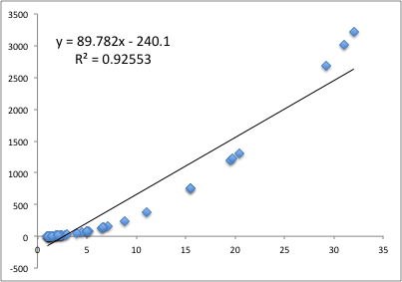
Linearity
If the relationship is not linear, then the fitted model will not fit the data properly across the domain of values

Slide 37
Linearity
Linearity:
How do we check it?
(1) Plot the raw data:
> plot(x,y)
> model<-lm(y~x)
> lines(x,model$fitted)

Slide 38
Linearity
What’s the solution?
Transform the response
Transform the predictors
e.g. Polynomial regression
THINK ABOUT WHAT RELATIONSHIP IS NATURALLY MEANINGFUL (ASSUMPTION 1)

Slide 39
Distribution of residuals
The parametric tests are mathematically derived, based on assumed distributions (e.g. normal, F)
Which means the tests can only be trusted when the data being tested follow the assumed distributions
e.g. t-tests and F-tests assume residuals are approximately normally distributed

Slide 40
Normality
.. the residuals of the model should be normally distributed
Why? Because t-tests and ANOVA assume normal residuals!
Frequency
0
Residuals

Slide 41
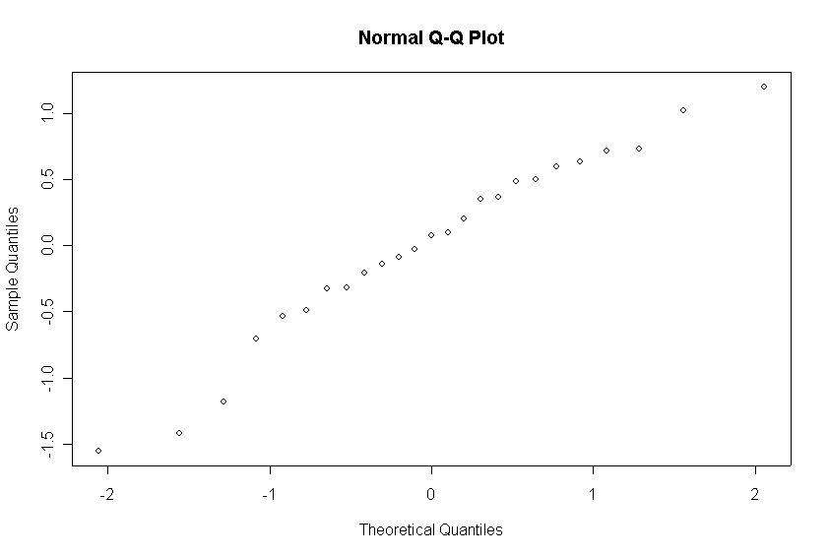
Normality
How do we check it?
Normality of residuals can be checked using a q-q plot

Slide 42
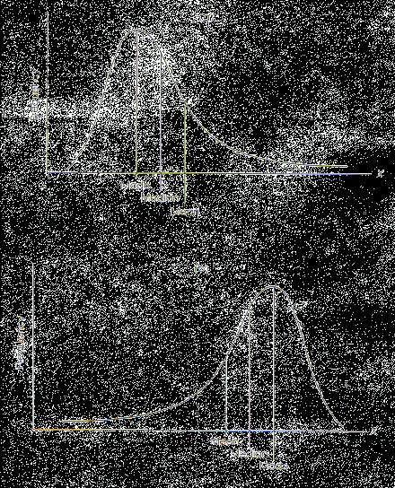
Distribution of residuals
Most common problem is positive skew:
Solution? Transform response variable
P
ositive

Slide 43
Homoscedasticity
Homogeneity of variances (Homoscedasticity):
i.e. the residuals (e_{i}’s) should have the same variance across values of the response variable
If not, then parameter estimates are likely to be unreliable

Slide 44
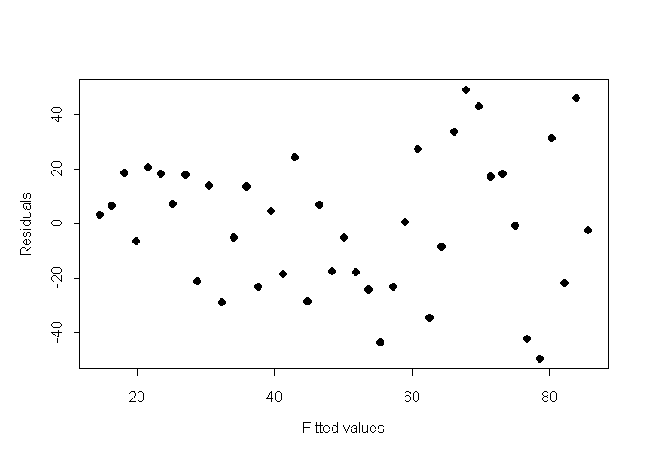
Homoscedasticity
How do we check it?
1) Plot residuals ( ) against fitted values ( )
Residuals should be evenly spread across the range of fitted values

Slide 45
Homoscedasticity
What can cause the assumption to be broken?
Skew (response or predictors require transformation)
Outliers
What’s the solution?
Transform the response variable or predictor variables

Slide 46
Checking diagnostics
This is easily done in R for lm() models
Use the plot() function on the derived lm() object and it will plot the errors for you.

Slide 47
Example: 1.6
Return to the fishspeed2 problem.
Run diagnostic plots for the model you constructed there

Slide 48
Diagnostics plot for lm() in R

Slide 49
End of Lecture 1

